Slide 1

MONOREPOS
GOOD
THE
BAD
THE
UGLY
AND THE
Notes:
Hello
Who am I?
Why I’m qualified to give this talk
Quick survey of experience
What this talk will not be:
Adovating monorepos
Google/Facebook scale monorepos
Questions:
anyone not familiar with packagemanagers, e.g. npm/yarn

Slide 2

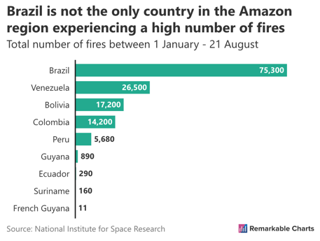
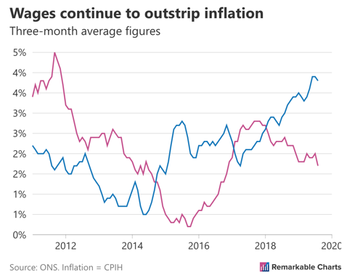
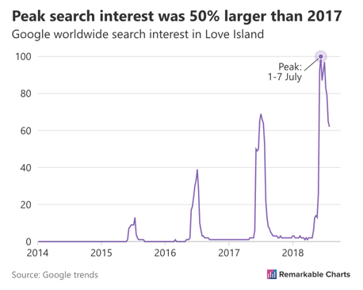
Notes:
Mention beard

Slide 3
The plan
The Good – why would I want one?
The Bad – what’s the catch?
The Ugly – how do I get one?
Notes:
The plan
Three parts: the Good, the Bad, and the Ugly

Slide 4
What is a monorepo?

Slide 5
Contains multiple packages or projects

Slide 6
Examples

Slide 7

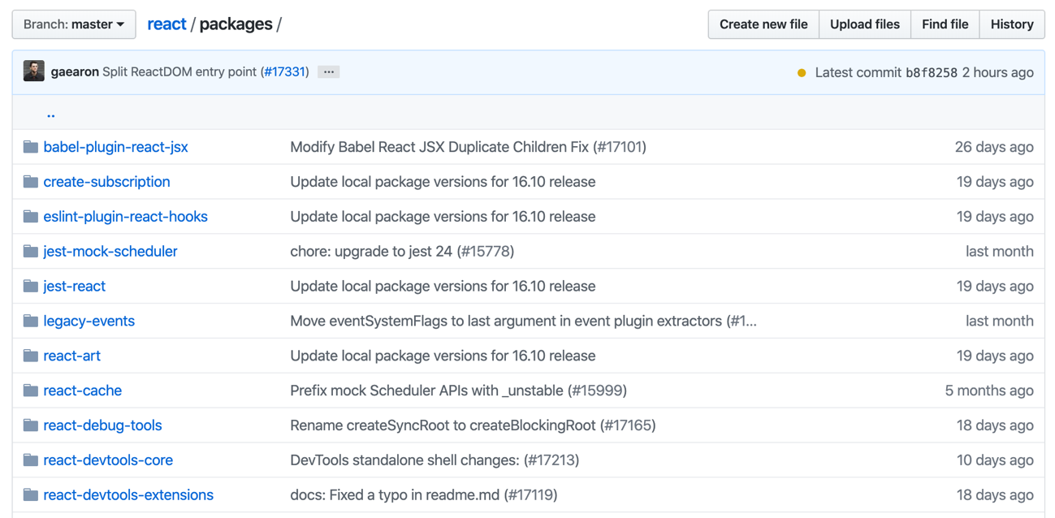
React
Notes:
Wont work at low res

Slide 8
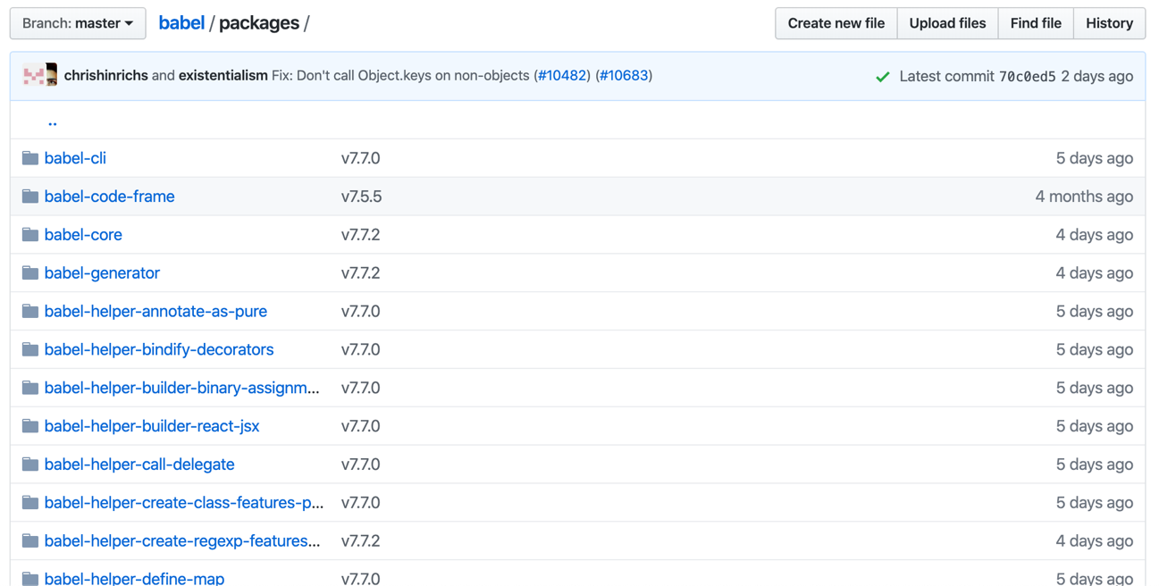
Babel
Notes:
Wont work at low res

Slide 9
“Juggling a multimodule project over multiple repos is like trying to teach a newborn baby how to ride a bike”

Slide 10
Alternatives
Monolith
Multirepo

Slide 11

THE GOOD
Notes:
Hello
Who am I?
Why I’m qualified to give this talk
Quick survey of experience
What this talk will not be:
Adovating monorepos
Google/Facebook scale monorepos
Questions:
anyone not familiar with packagemanagers, e.g. npm/yarn

Slide 12
Why would I want one?
One development environment
Common configuration
Cross package changes
Single culture

Slide 13
One development environment
Everything in one place
Backend and frontend
Easy to get started

Slide 14
Common configuration
Top level eslint/prettier/babel
Less convention switching

Slide 15
Cross package changes
One pull request for feature spanning multiple packages
One review

Slide 16
Single culture
Software is easy
People are hard

Slide 17
THE BAD
Notes:
Hello
Who am I?
Why I’m qualified to give this talk
Quick survey of experience
What this talk will not be:
Adovating monorepos
Google/Facebook scale monorepos
Questions:
anyone not familiar with packagemanagers, e.g. npm/yarn

Slide 18
What’s the catch?
Bigger repository
Longer build times
Broken master
Tooling less mature
Fewer resources
Incompatible culture

Slide 19
Bigger repository
¯\_(ツ)_/¯

Slide 20
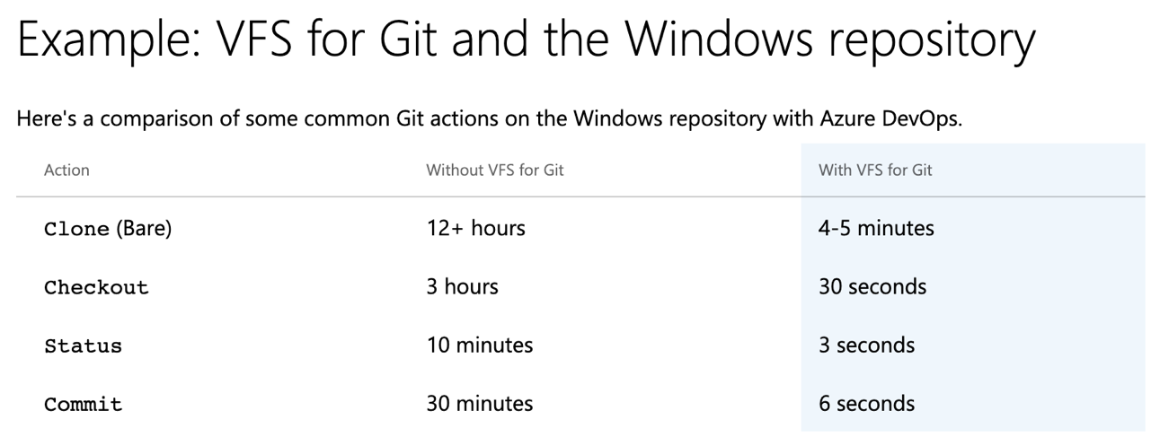
Bigger repository

Slide 21
Longer build times
Notes:
https://medium.com/@reuvenharrison/using-circleci-with-monorepos-c04b03f9f39c
Working nicely with CI tools often requires scripting

Slide 22
Broken master

Slide 23
Tooling less mature
Tools assume things that don’t hold for monorepos
Continuous Integration tools are tricky
Notes:
Fewer tools have a monorepo in mind

Slide 24
Fewer resources
Sometimes you’re on your own

Slide 25
Incompatible culture
Requires trust
Having your own repository can free you from bureaucracy
Quality of code reviews
Shared ownership
Notes:
Quality of code reviews
-
Shared ownership
- Gatekeepers will be a problem

Slide 26

THE UGLY
Notes:
Hello
Who am I?
Why I’m qualified to give this talk
Quick survey of experience
What this talk will not be:
Adovating monorepos
Google/Facebook scale monorepos
Questions:
anyone not familiar with packagemanagers, e.g. npm/yarn

Slide 27
How do I get a monorepo?

Slide 28
Incremental migration
Monolith -> monorepo
Multirepo -> monorepo
DEMO

Slide 29
Incremental migration
Multirepo
Monorepo
Monolith

Slide 30
Demo
cambridge-bumps-website
react-bumps-chart
react-rowing-blades

Slide 31
Yarn workspaces
Run yarn install once to install dependencies for multiple packages
Notes:
https://yarnpkg.com/lang/en/docs/workspaces/

Slide 32
Why would you want to do this?
Your dependencies can be linked together
More latitude to optimize dependencies
Single lockfile
Notes:
Your dependencies can be linked together, which means that your workspaces can depend on one another while always using the most up-to-date code available. This is also a better mechanism than yarn link since it only affects your workspace tree rather than your whole system.
All your project dependencies will be installed together, giving Yarn more latitude to better optimize them.
Yarn will use a single lockfile rather than a different one for each project, which means fewer conflicts and easier reviews.

Slide 33
Lerna
Optimizes managing multi-package repositories with git and npm

Slide 34
Lerna
Manages
Testing
Building
Versioning
Releasing

Slide 35
Lerna
To make this really useful we create top level scripts

Slide 36
In conclusion

Slide 37
Is it right for me or my team?

Slide 38



Technical
Cultural

Slide 39
Technical
Tooling

Slide 40
Cultural
Shared ownership

Slide 41

THANKS
MONOREPOS
GOOD
THE
BAD
THE
UGLY
AND THE
Notes:
Hello
Who am I?
Why I’m qualified to give this talk
Quick survey of experience
What this talk will not be:
Adovating monorepos
Google/Facebook scale monorepos
Questions:
anyone not familiar with packagemanagers, e.g. npm/yarn

